Slide 1
Narcissists can talk about themselves
TEAM MEMBERS:
BHAVIYA GANDANI
JULIA VALENCIA
FELICIA AUBERT
RICHARD MCNELEY
VIRAJ MANJAREKAR

Slide 2
Problem Domain / Scope:
Main idea: Narcissists can talk about themselves.
Problem domain:
which features to implement?
How to budget feature implementation and task management to hit the deadline?
Implemented features:
Blog posts, login/logout functionality, image upload and display, questionnaire and profile.

Slide 3
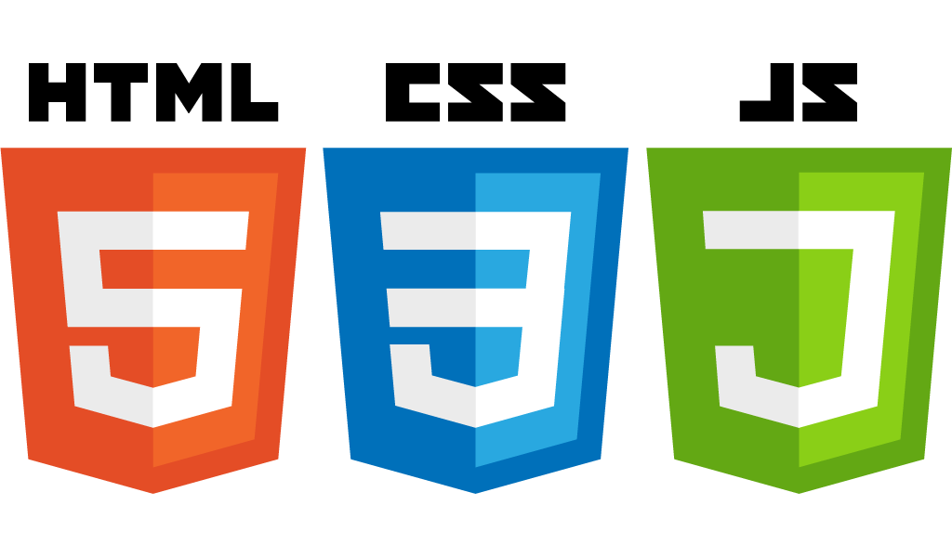




Technologies Used:
Front-End:
- HTML
- BootStrap + CSS
- Javascript
Back-End:
- Node Js
- Ajax
- JQuery
Deployment:
- Deployd

Slide 4
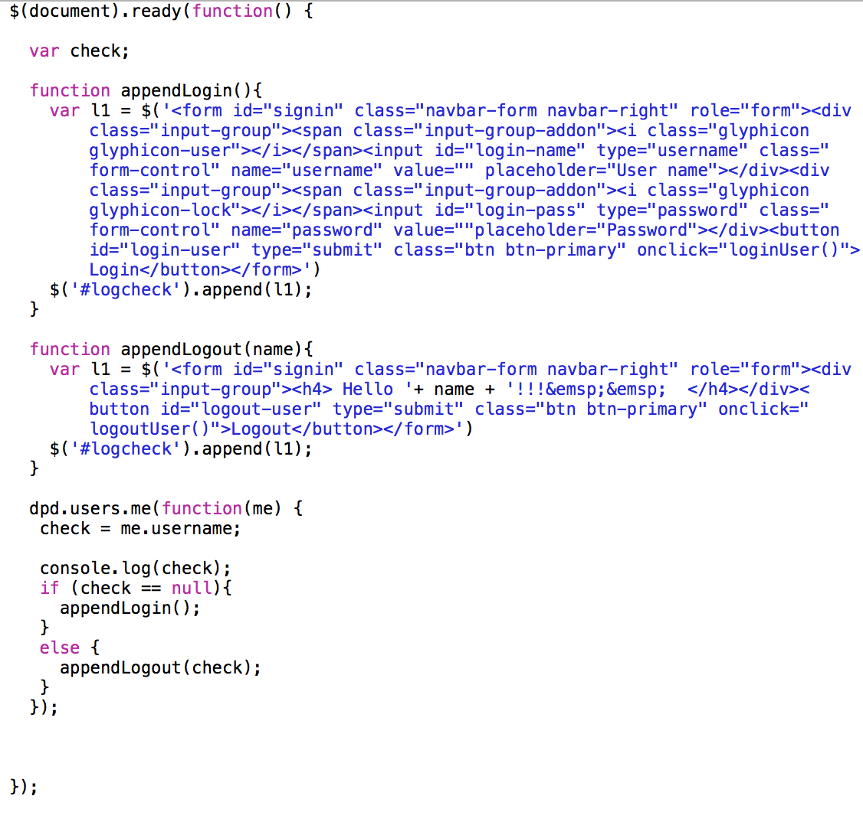
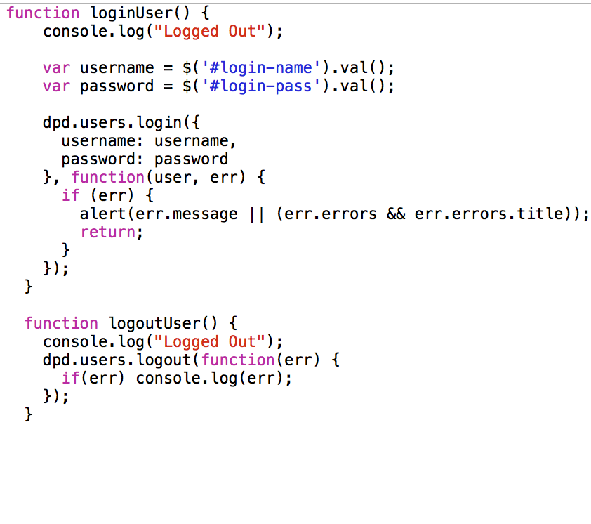
Code Snippets:
Login:

Slide 5
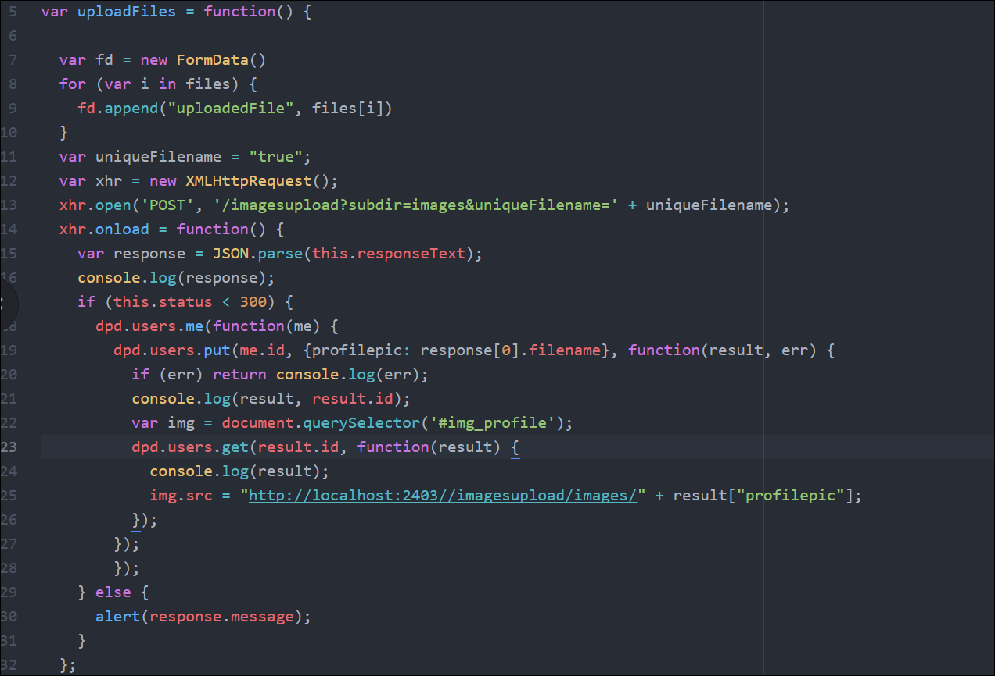
Profile Photo Upload:

Slide 6
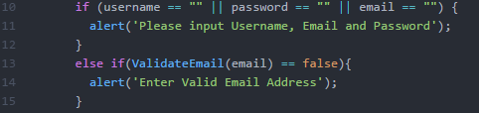
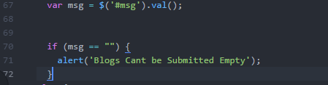
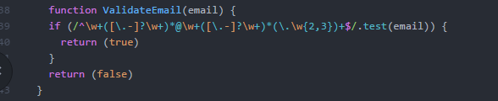
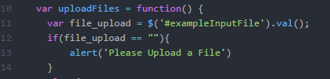
Validation:

Slide 7
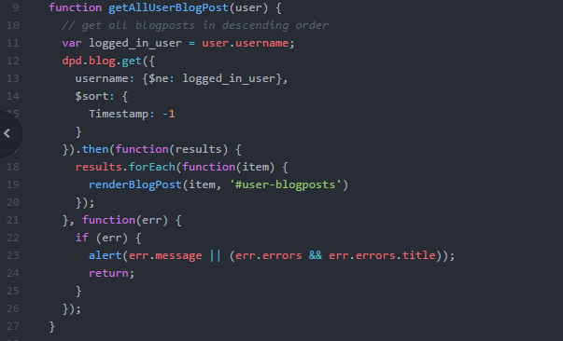
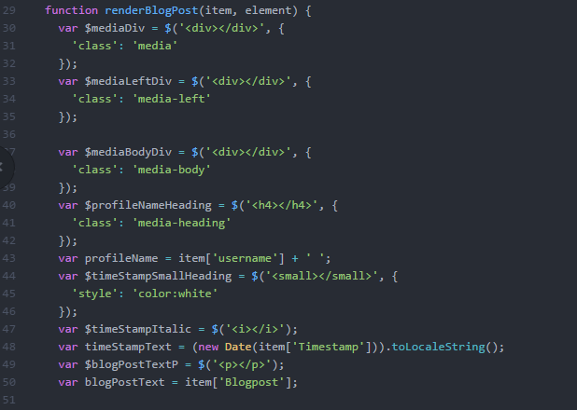
Public Posts:

Slide 8
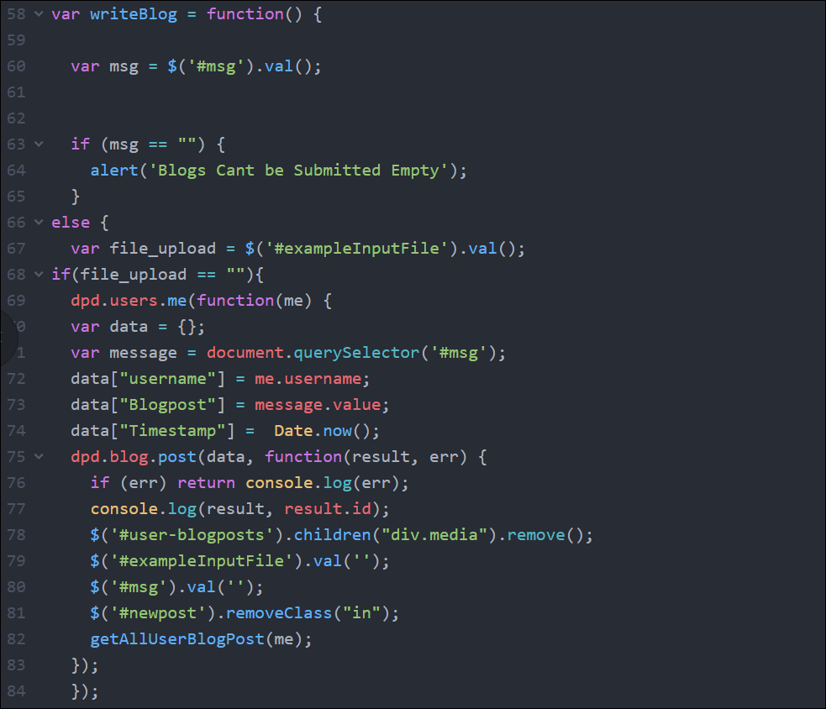
Blog Upload: Without Image

Slide 9
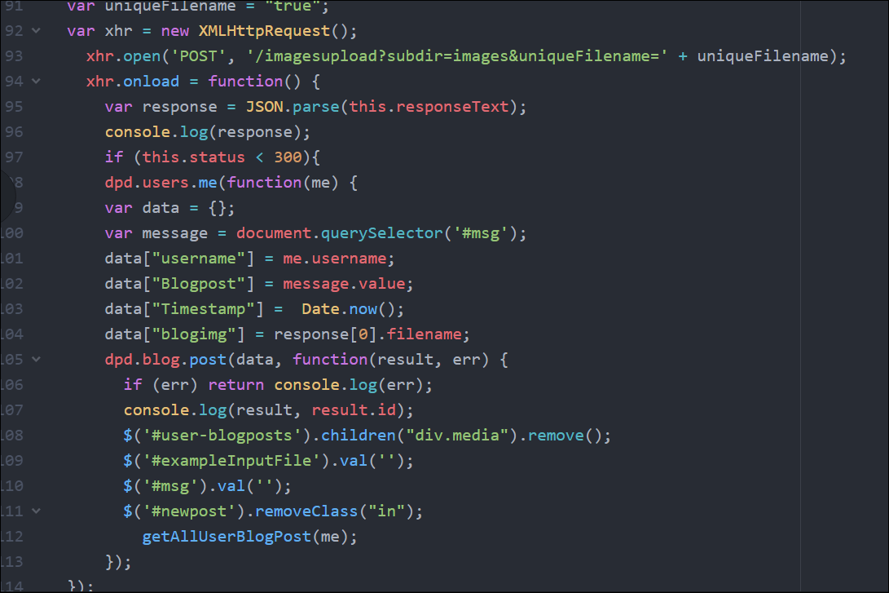
Blog Upload: With Image

Slide 10
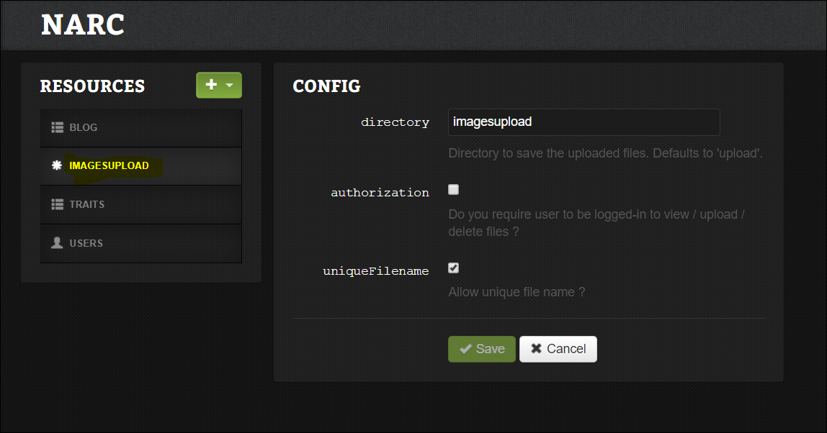
DPD Fileupload Collection:

Slide 11
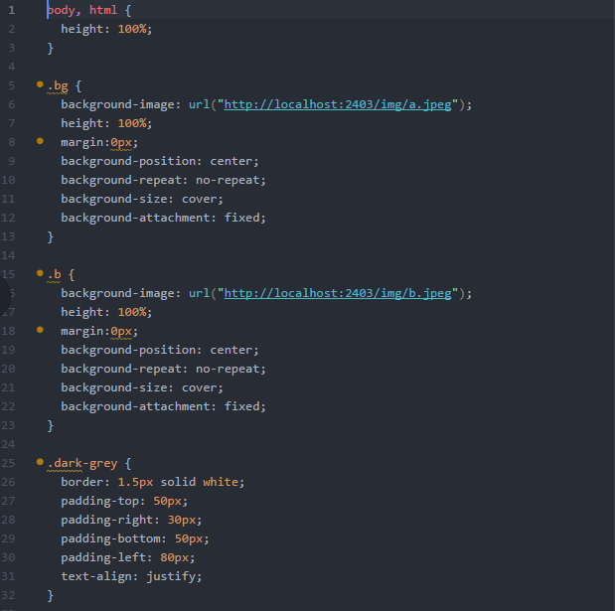
Stylesheet: (styles.css)

Slide 12
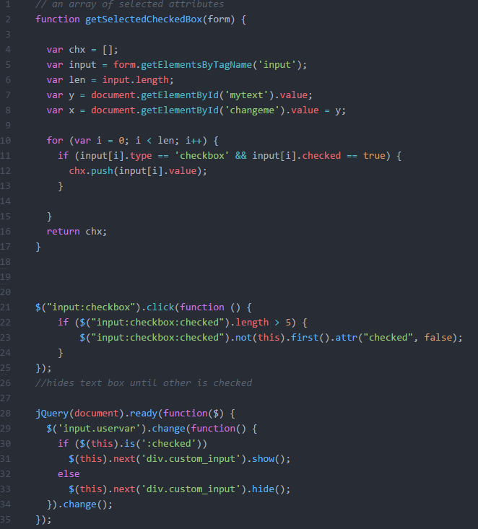
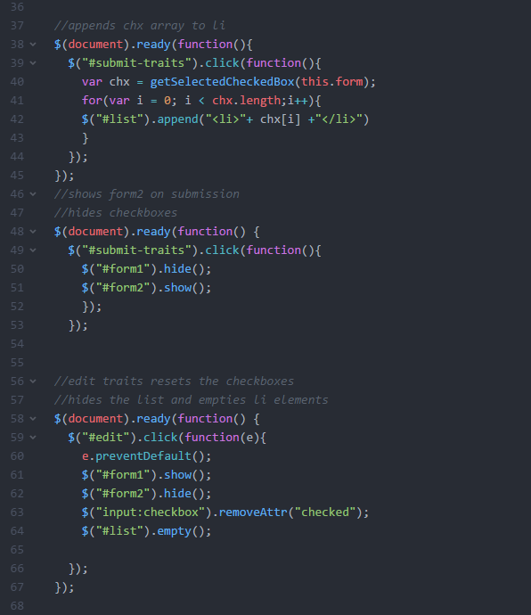
Traits:

Slide 13
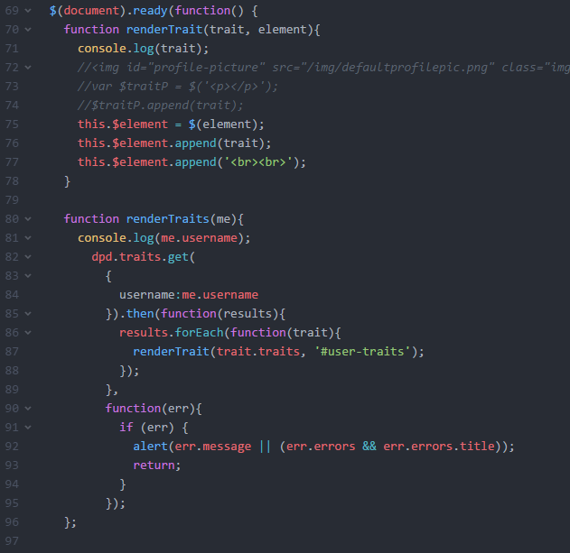
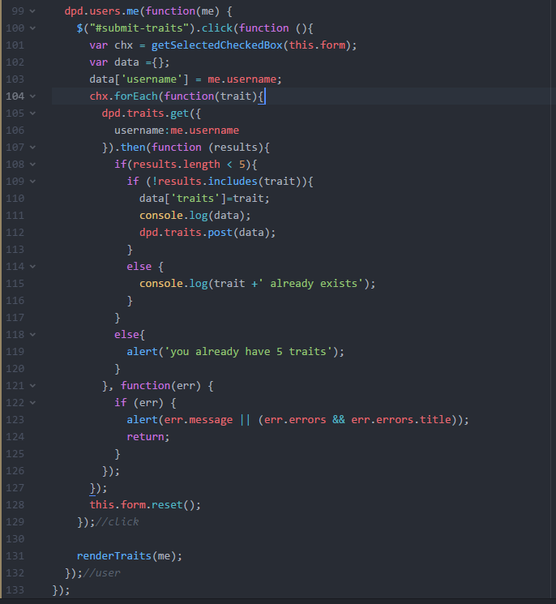
Render Traits:

Slide 14
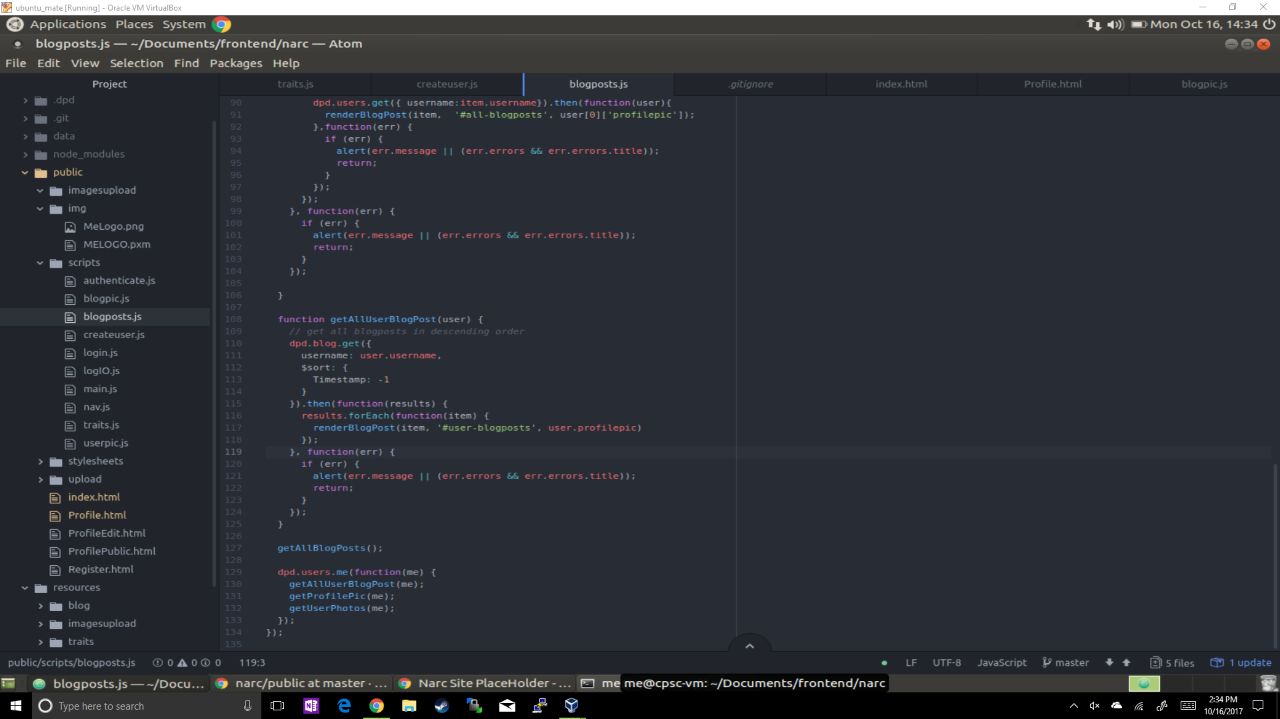
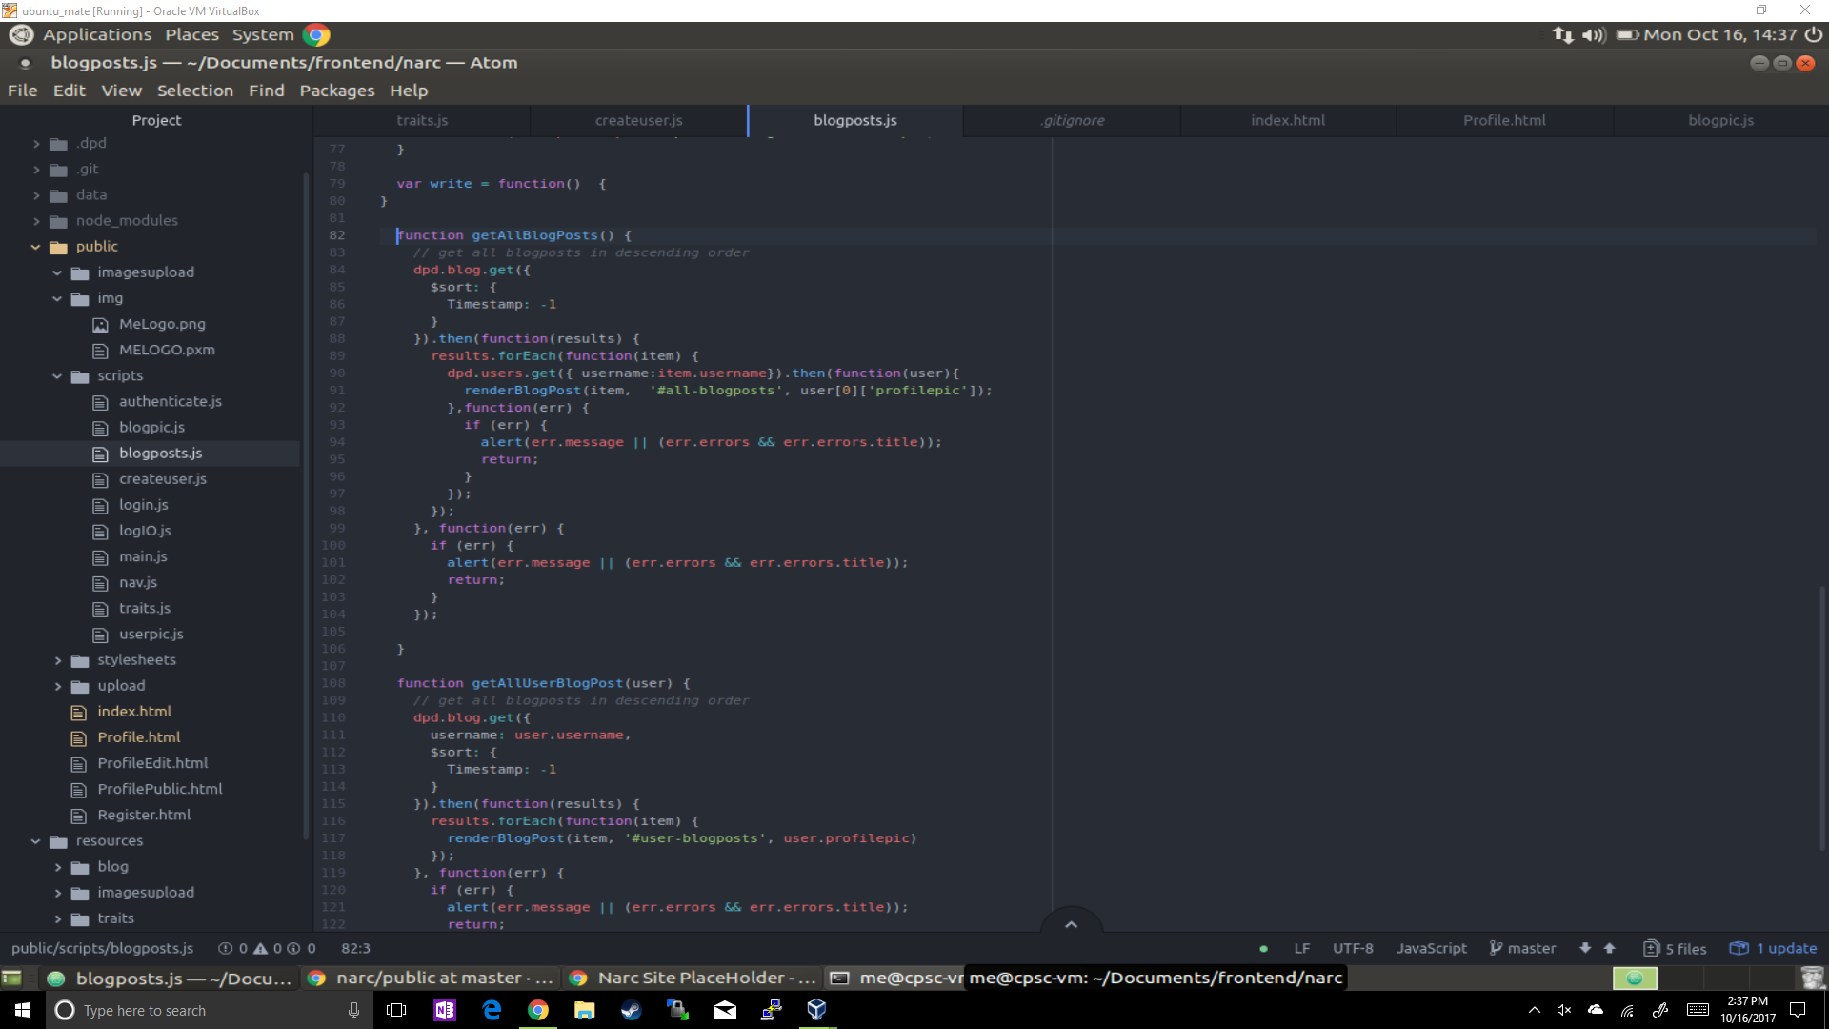
Render Blog Posts:

Slide 15
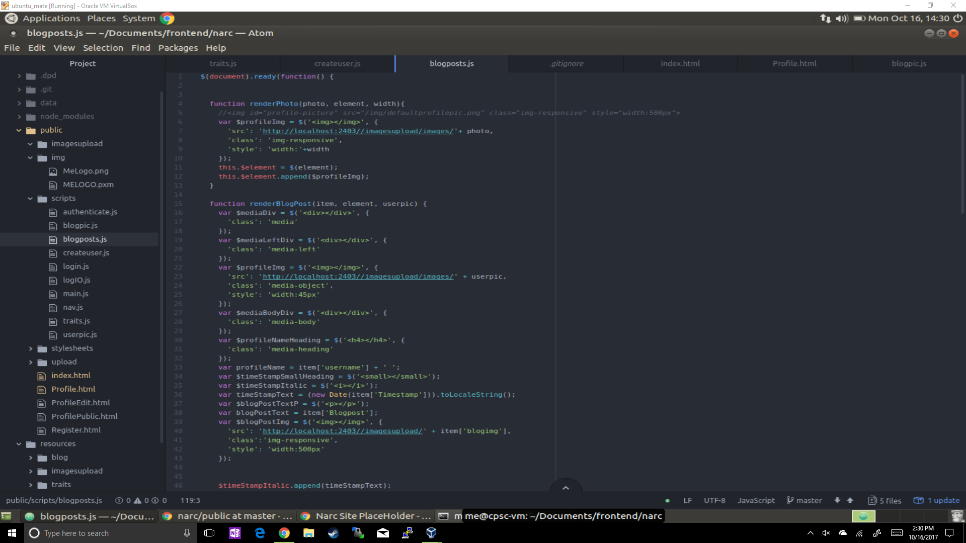
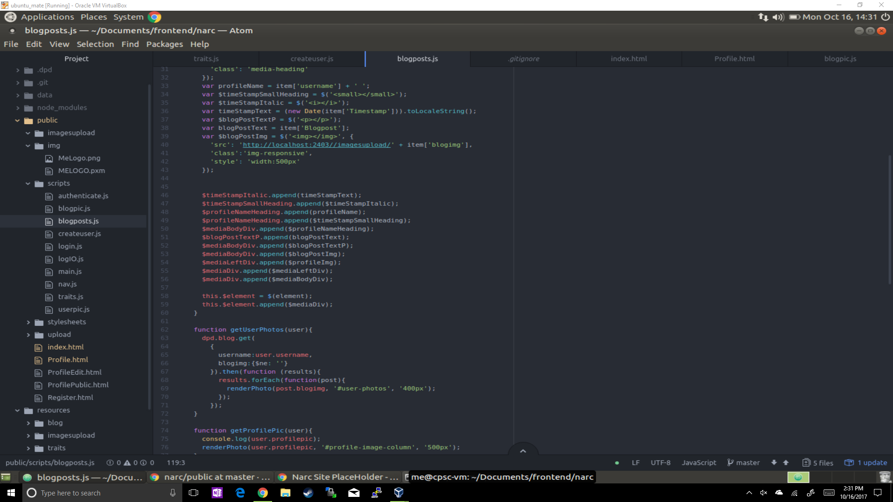
Rendering Blog Posts:

Slide 16
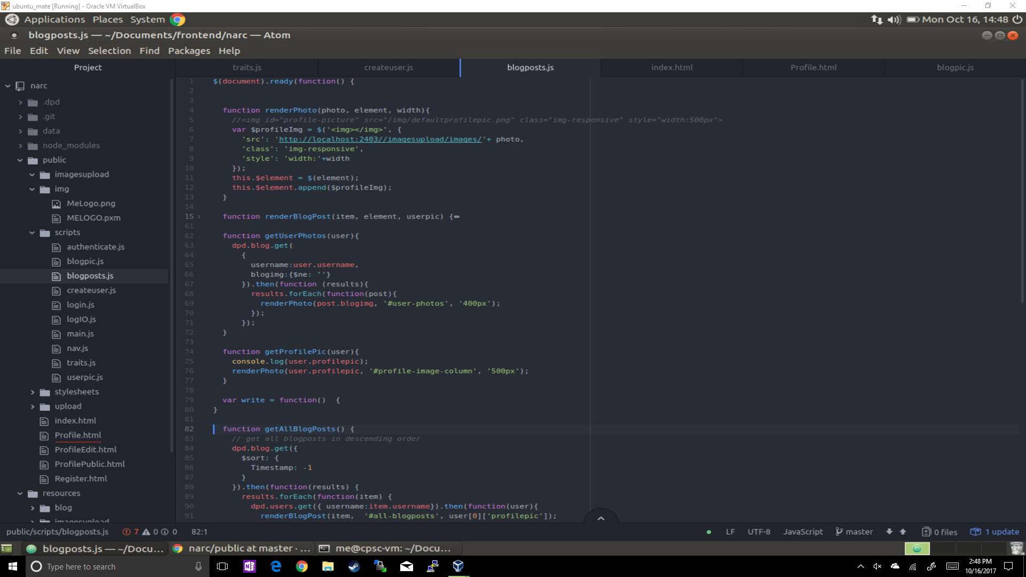
Rendering User Photos and Profile Picture:

Slide 17
Future Scope:
About me section
for more personal information
Sticky profile picture
a profile picture that will always be on the left hand side to see even while scrolling through blog posts

Slide 18
Thank You!

Slide 19
Sources:
Bhardwaj, Arvind, (2017). [online] Available at: //https://stackoverflow.com/questions/18378182/limit-checkbox-select-and-move-the-selection-to-the-first-choice [Accessed 16 Oct. 2017].
Donnelly, James, (2017). jquery - show textbox when checkbox checked. [online] Stackoverflow.com. Available at: https://stackoverflow.com/questions/19670323/jquery-show-textbox-when-checkbox-checked [Accessed 16 Oct. 2017].

